Slide 1
Foundations of Data Science & Analytics DSCI 633
Lecture 12
Nidhi Rastogi
Assistant Professor, GCCIS, RIT

Slide 2
Lecture Agenda
Feature Engineering

Slide 3
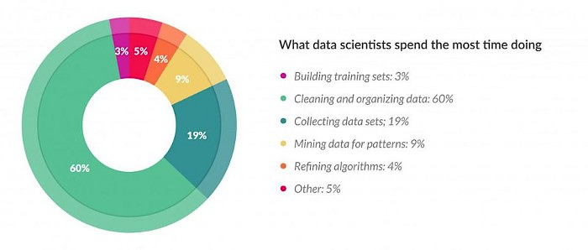
Introduction
Reality of a Data Scientist role – a lot of time spent in feature engineering
https://www.forbes.com/sites/gilpress/2016/03/23/data-preparation-most-time-consuming-least-enjoyable-data-science-task-survey-says/#1594bda36f63

Slide 4
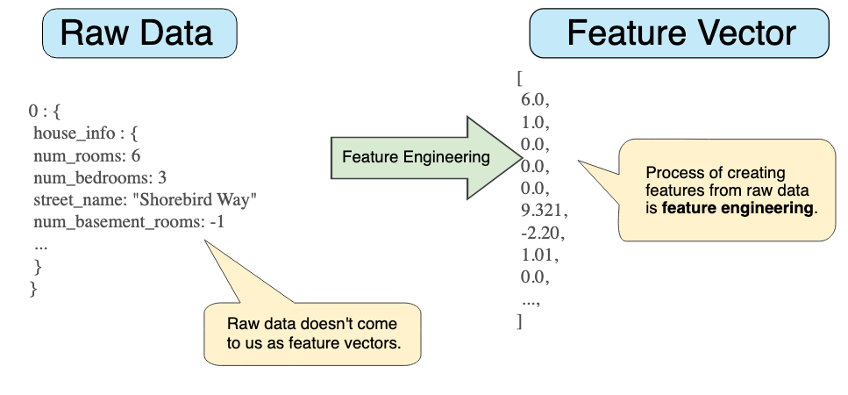
What is a Feature
A numerical representation of an aspect of raw data.
https://developers.google.com/machine-learning/crash-course/representation/feature-engineering

Slide 5
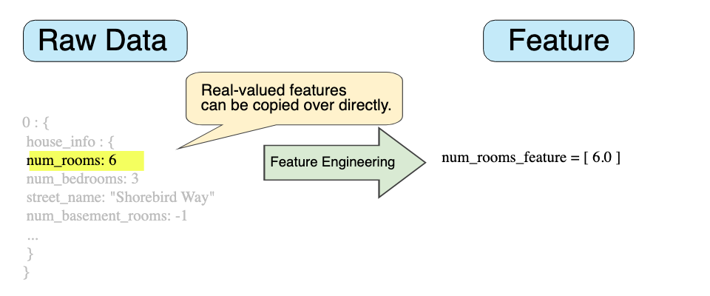
What is a Feature
A numerical representation of an aspect of raw data.
https://developers.google.com/machine-learning/crash-course/representation/feature-engineering

Slide 6
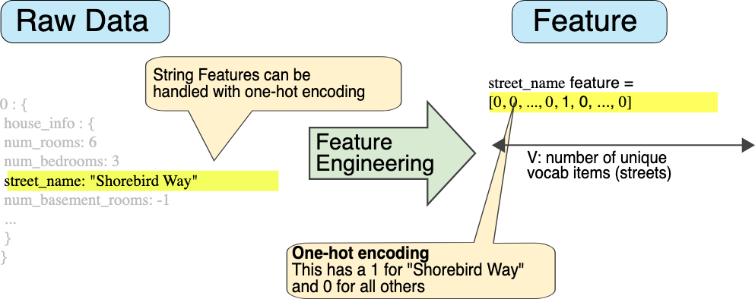
What is a Feature
A numerical representation of an aspect of raw data.
Features sit between data and models in the ML pipeline.
https://developers.google.com/machine-learning/crash-course/representation/feature-engineering

Slide 7
What is Not Feature Engineering
data collection
creating target variable
removing duplicates
fixing mislabeled classes.

Slide 8
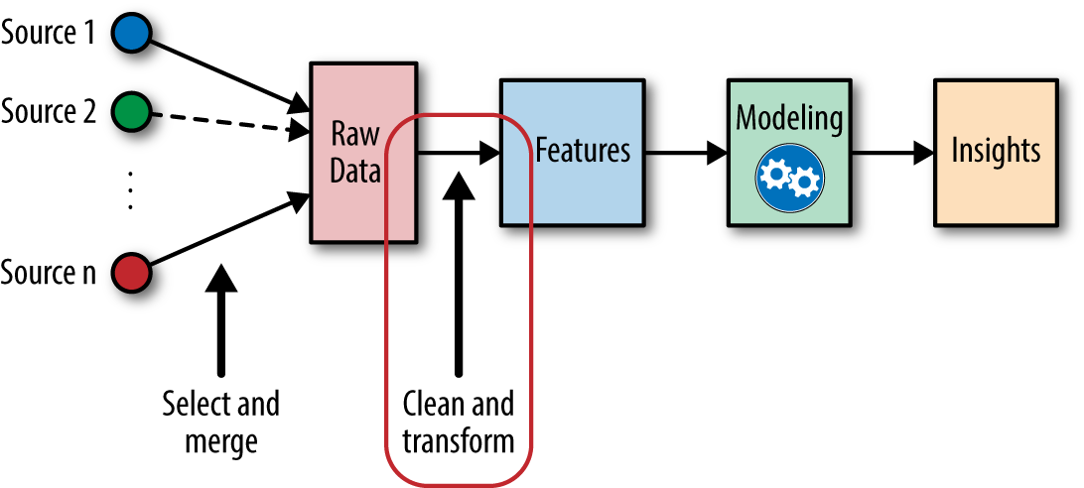
What is Feature Engineering
Extracting features from raw data and transforming them into formats that are suitable for the machine learning model
A crucial step in the machine learning pipeline because the right features can ease the difficulty of modeling
enable the pipeline to output results of higher quality

Slide 9
Feature Engineering
Why Feature Engineering matters
Extract more new gold features, remove irrelevant or noisy features
Simpler models with better results
Challenges
Powerful feature transformations (like target encoding) can introduce leakage when applied wrong.
Usually requires domain knowledge about how features interact with each other.
Time-consuming with big data, may need to run thousands of experiments.

Slide 10
Key Elements of FE
Feature Encoding
Feature Extraction
Target Transformation

Slide 11
Feature Encoding
Turns categorical features into numeric features
provide more fine-grained information
Help explicitly capture non-linear relationships and interactions between the values of features.
The algorithm can understand the format.
Most machine learning tools only accept numbers as their input
e.g., xgboost, gbm, glmnet, libsvm, liblinear, etc

Slide 12
Feature Encoding
Turns categorical features into numeric features
provide more fine-grained information
Help explicitly capture non-linear relationships and interactions between the values of features.
The algorithm can understand the format.
Most machine learning tools only accept numbers as their input
e.g., xgboost, gbm, glmnet, libsvm, liblinear, etc

Slide 13
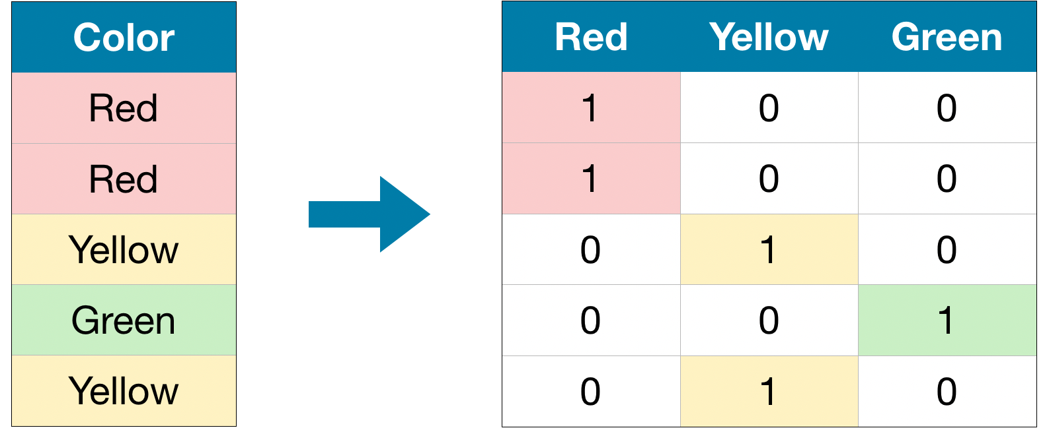
Categorical Features
Represent Categories or labels
Four Seasons, Favorite Player, Colors
Usually finite in a real-world dataset
Unlike other numeric variables, the values of a categorical variable cannot be ordered with respect to one another. (Red is neither greater than nor less than Yellow as a color.) They are called “non-ordinal”.

Slide 14
Categorical Features
Litmus test for whether something should be a categorical variable
“Does it matter how different two values are, or only that they are different?”
A stock price of $500 is five times higher than a price of $100. So, stock price should be represented by a continuous numeric variable.

Slide 15
Categorical Features
Large categorical variables are common in transactional records.
Example: many web services track users using an ID, which is a categorical variable
Like using IP address of an internet transaction
categorical variable even though user IDs and IP addresses are numeric
Magnitude is usually not relevant to the task at hand
For instance, IP address is relevant when doing fraud detection on individual transactions
some IP addresses or subnets may generate more fraudulent transactions
But one IP is not inherently more fraudulent than the other

Slide 16
Feature Encoding
Turn categorical features into numeric features
provide more fine-grained information
Help explicitly capture non-linear relationships and interactions between the values of features
Algorithm can understand the format.
Most of machine learning tools only accept numbers as their input e.g., xgboost, gbm, glmnet, libsvm, liblinear, etc.

Slide 17
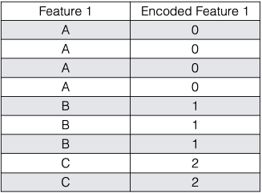
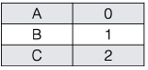
Encoding Categorical
Labeled Encoding
Interpret the categories as ordered integers (mostly wrong)
Python scikit-learn: LabelEncoder
OK for tree-based methods

Slide 18
Encoding Categorical
One Hot Encoding
Transform categories into individual binary (0 or 1) features
Python scikit-learn: DictVectorizer, OneHotEncoder
OK for K-means, Linear Regression, NNs, etc.
One of the most common encoding methods in ML

Slide 19
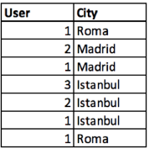
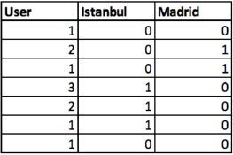
One Hot Encoding
Spreads values in a column to multiple flag columns
assigns 0 or 1 to them.
Binary values express relationship between grouped and encoded column.
Mathematically, one can write this constraint as “the sum of all bits must be equal to 1”:
One hot encoding example of City column

Slide 20
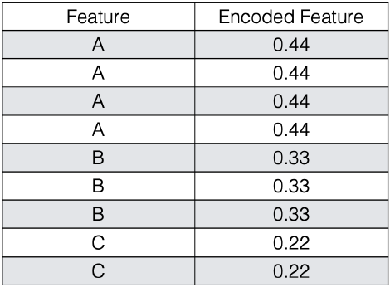
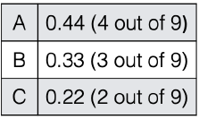
Frequency Encoding
Encoding of categorical levels of feature to values between 0 and 1 based on their relative frequency

Slide 21
Target mean encoding
Substitutes category of k-th training example with one numeric feature equal to some target statistic (e.g. mean, median or max of target).
Different types of target encoding
Greedy
Holdout
K-fold
Ordered (not used commonly)

Slide 22
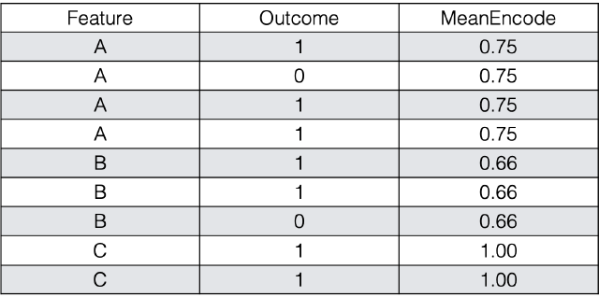
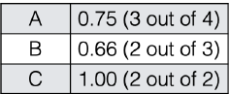
Target mean encoding
Instead of dummy encoding of categorical variables and increasing the number of features we can encode each level as the mean of the response.
To read more: https://docs.h2o.ai/h2o/latest-stable/h2o-docs/data-science/target-encoding.html

Slide 23
Target mean Encoding
Works for both binary classification and regression
For multiclass classification:
encode the categorical variable with m-1 new variables, where m is the number of classes.
Limitations?

Slide 24
Target mean Encoding
Limitations
Some of the categories have few training examples
Mean target value for these categories may assume extreme values
….
Encoding these values with mean may reduce model performance
Solution: Target mean for the category mixed with marginal mean of the target variable

Slide 25
Target mean Encoding
Solution: Target mean for the category mixed with marginal mean of the target variable
weights are close to one for the categories with many training examples and close to zero for rare categories.

Slide 26
Target mean Encoding smoothing
Intuition: Imagine a new movie is posted on IMDB and it receives three ratings. Taking into account the three ratings gives the movie an average of 9.5. This is surprising because most movies tend to hover around 7, and the very good ones rarely go above 8. The point is that the average can’t be trusted because there are too few values. The trick is to “smooth” the average by including the average rating over all movies. In other words, if there aren’t many ratings we should rely on the global average rating, whereas if there enough ratings then we can safely rely on the local average.

Slide 27
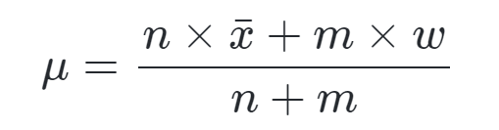
Target mean Encoding smoothing
Mathematically this is equivalent to:
where
μ is the mean we’re trying to compute (the one that’s going to replace our categorical values)
n is the number of values you have
x¯ is your estimated mean
m is the “weight” you want to assign to the overall mean
w is the overall mean

Slide 28
Target mean Encoding
What type of encoding did we just study?
- Greedy

Slide 29
Target mean Encoding
Next
Greedy
Hold Out

Slide 30
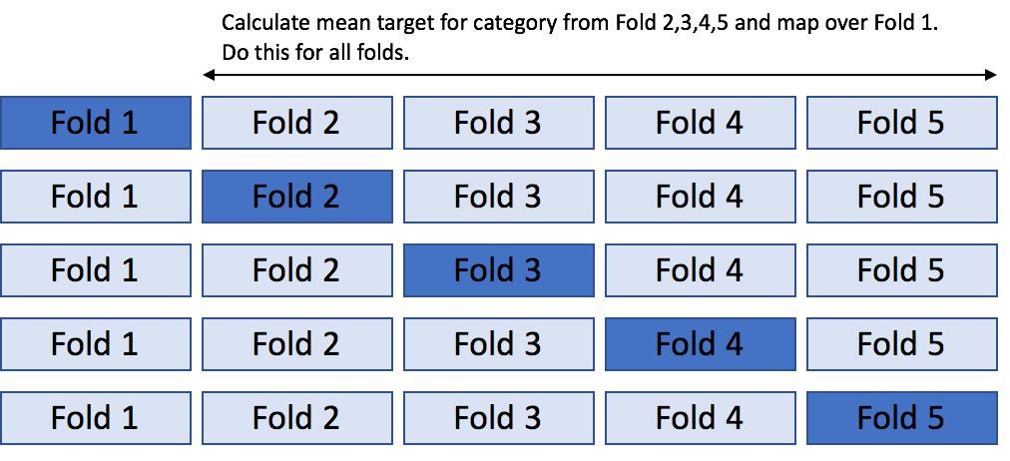
Target mean encoding
K – hold out
Most commonly used approach
Solves issue of overfitting on the training data (“mostly”, not always)
Idea similar to k-fold cross validation.
Divide the data in K- stratified or random folds
Replace observations present in (k-1)_th fold with mean target of data from all others except (k-1)_th fold.

Slide 31
Target mean encoding leave-one-out schema
To avoid overfitting we could use leave-one-out schema
Special case of Hold-Out
K-fold when K=2
used when we have small dataset
calculate target statistic for each observation by using labels from all except that particular observation.

Slide 32
Target mean encoding leave-one-out schema
To avoid overfitting we could use leave-one-out schema

Slide 33
Target mean encoding leave-one-out schema
To avoid overfitting we could use leave one out schema

Slide 34
Target mean encoding leave-one-out schema
To avoid overfitting we could use leave one out schema

Slide 35
Target mean encoding leave-one-out schema
To avoid overfitting we could use leave one out schema

Slide 36
Target mean encoding leave-one-out schema
To avoid overfitting we could use leave one out schema

Slide 37
Weight of Evidence and Information Value
Weight of evidence
To avoid division by zero
Information Value

Slide 38
Weight of Evidence and Information Value
Weight of evidence: tells the predictive power of an independent variable in relation to the dependent variable.
Information Value: most useful technique to select important variables in a predictive model. It helps to rank variables on the basis of their importance. The IV is calculated using the following formula :

Slide 39
Weight of Evidence and Information Value
0.221

Slide 40
Weight of Evidence and Information Value

Slide 41
Target Transformation
Manual or Automatic
Fit transform on training dataset
Apply to train and test. Invert transform on prediction
Use it when variable shows a skewed distribution make residuals more close to “normal distribution” (bell curve)
Can improve model fit
e.g., log(x), log(x+1), sqrt(x), sqrt(x+1), etc.

Slide 42
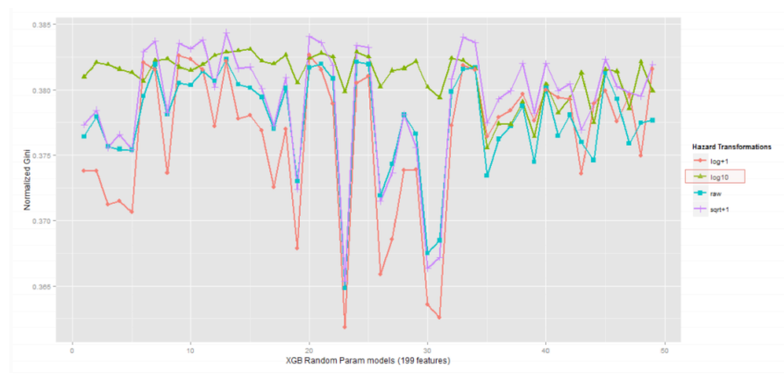
Target Transformation
Different transformations might lead to different results

Slide 43
Key Elements of FE
Target Transformation
Feature Extraction
Feature Encoding

Slide 44
Imputation
Common problem in preparing data: Missing Values
Why we have missing values?
Human errors
Interruptions in data flow
Privacy concerns
What to do?

Slide 45
Imputation
What to do?
• Simple solution: drop row/column
• Preferable option: Imputation

Slide 46
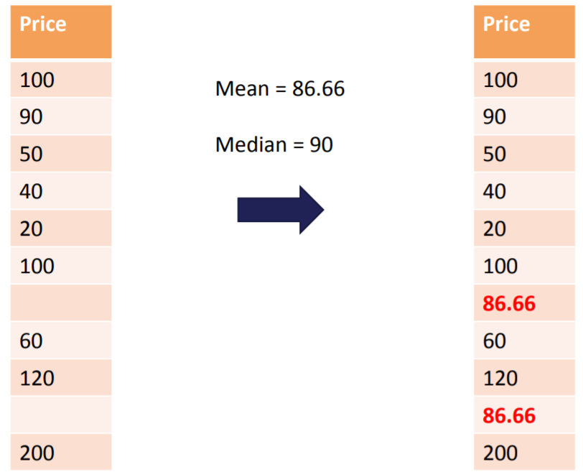
Imputation
Numerical Imputation – better than dropping since it preserves data size
zero
NA
Which one to pick?
Default value or medians of columns (Note that averages are sensitive to outlier values)

Slide 47
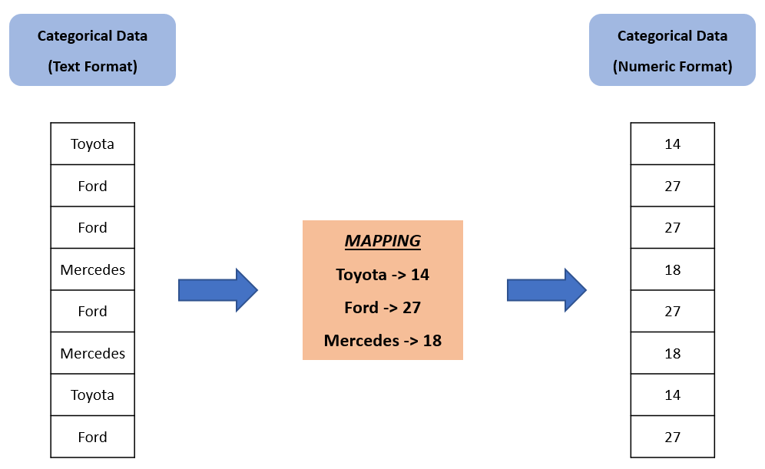
Imputation
Categorical Imputation
Maximum occurred value
There is not a dominant value, imputing a category like “Other”
Text -> numeric format

Slide 48
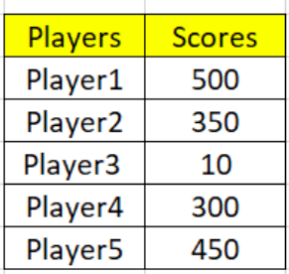
Outliers
Mistake?
Variance?

Slide 49
Outlier/Anomaly detection
Outlier: A data object that deviates significantly from normal objects as if it were generated by a different mechanism
Outliers are different from noise data
Noise is random error or variance in a measured variable
Noise should be removed before outlier detection
Outliers are interesting: It violates mechanism that generates normal data
Outlier detection vs. novelty detection: early stage, outlier; but later merged into model
Applications?

Slide 50
Outlier/Anomaly detection
Applications:
Credit card fraud detection
Telecom fraud detection
Customer segmentation
Medical analysis

Slide 51
Types of Outliers
Global, contextual and collective outliers
Global outlier (or point anomaly)
Object significantly deviates from rest of data set
Ex. Intrusion detection in computer networks
Issue: Find an appropriate measurement of deviation

Slide 52
Types of Outliers
Contextual outlier (or conditional outlier)
Object deviates significantly based on a selected context
Ex. 80degree F in Rochester: outlier? (depending on summer or winter?)
Attributes of data objects should be divided into two groups
Contextual attributes: defines context, e.g., time & location
Behavioral attributes: characteristics of object, used in outlier evaluation, e.g., temperature
Can be viewed as a generalization of local outliers—whose density significantly deviates from its local area
Issue: How to define or formulate meaningful context?

Slide 53
Types of Outliers
Collective Outliers
A subset of data objects collectively deviate significantly from whole data set, even if individual data objects may not be outliers
Applications: E.g., intrusion detection:
When a number of computers keep sending denial-of-service packages to each other
Detection of collective outliers
Consider not only behavior of individual objects, but also that of groups of objects
Need to have background knowledge on relationship among data objects, such as a distance or similarity measure on objects.
A data set may have multiple types of outlier
One object may belong to more than one type of outlier

Slide 54
Finding Outliers
To ease discovery of outliers, we have plenty of methods in statistics:
Discover outliers with visualization tools or statistical methodologies
Box plot
Scatter plot
Z-score
IQR score

Slide 55
Box Plot
Wikipedia: In descriptive statistics, a box plot is a method for graphically depicting groups of numerical data through their quartiles. Box plots may also have lines extending vertically from boxes (whiskers) indicating variability outside upper and lower quartiles, hence terms box-and-whisker plot and box-and-whisker diagram. Outliers may be plotted as individual points.

Slide 56
Box Plot
Definition suggests, that if there is an outlier it will plotted as point in
boxplot but other population will be grouped together and display as boxes.

Slide 57
Box Plot
Three points between 10 to 12, these are outliers as there are
not included in box of other observation i.e no where near quartiles.
• Here we analyzed uni-variate outlier i.e. we used DIS column only to check outlier.

Slide 58
Scatter Plot
Wikipedia: A scatter plot , is a type of plot or mathematical diagram using Cartesian coordinates to display values for typically two variables for a set of data. data are displayed as a collection of points, each having value of one variable determining position on horizontal axis and value of other variable determining position on vertical axis.

Slide 59
Scatter Plot
Definition suggests, scatter plot is collection of points that shows values for two variables.
Most of data points are lying bottom left side but there are points which are far from population like top right corner.

Slide 60
Standard Deviation
Wikipedia: In statistics, standard deviation (SD, also represented by lower case Greek letter sigma σ for population standard deviation or Latin letter s for sample standard deviation) is a measure of amount of variation or dispersion of a set of values.
If a value has a distance to average higher than x * standard deviation, it can be assumed as an outlier. Then what x should be?
Usually, a value between 2-4

Slide 61
Z-score
Wikipedia: Z-score is signed number of standard deviations by which value of an observation or data point is above mean value of what is being observed or measured.
Intuition: describe any data point by finding their relationship with Standard Deviation and Mean of group of data points.
Z-score is finding distribution of data where mean is 0 and standard deviation is 1 i.e. normal distribution.

Slide 62
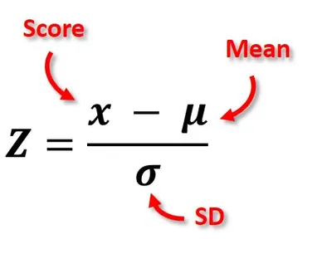
Z-score
While calculating Z-score we re-scale and center data and look for data points which are too far from zero. These data points which are way too far from zero will be treated as outliers. In most of cases a threshold of 3 or -3 is used i.e if Zscore value is greater than or less than 3 or -3 respectively, that data point will be identified as outliers.

Slide 63
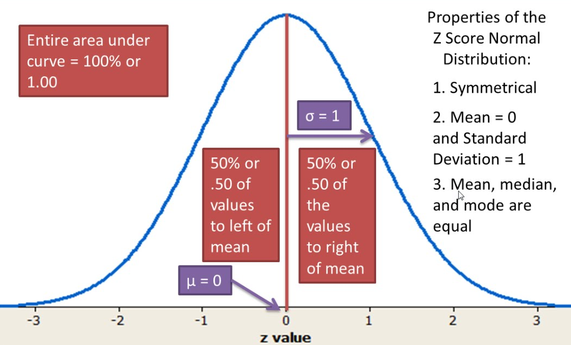
Z-Score

Slide 64
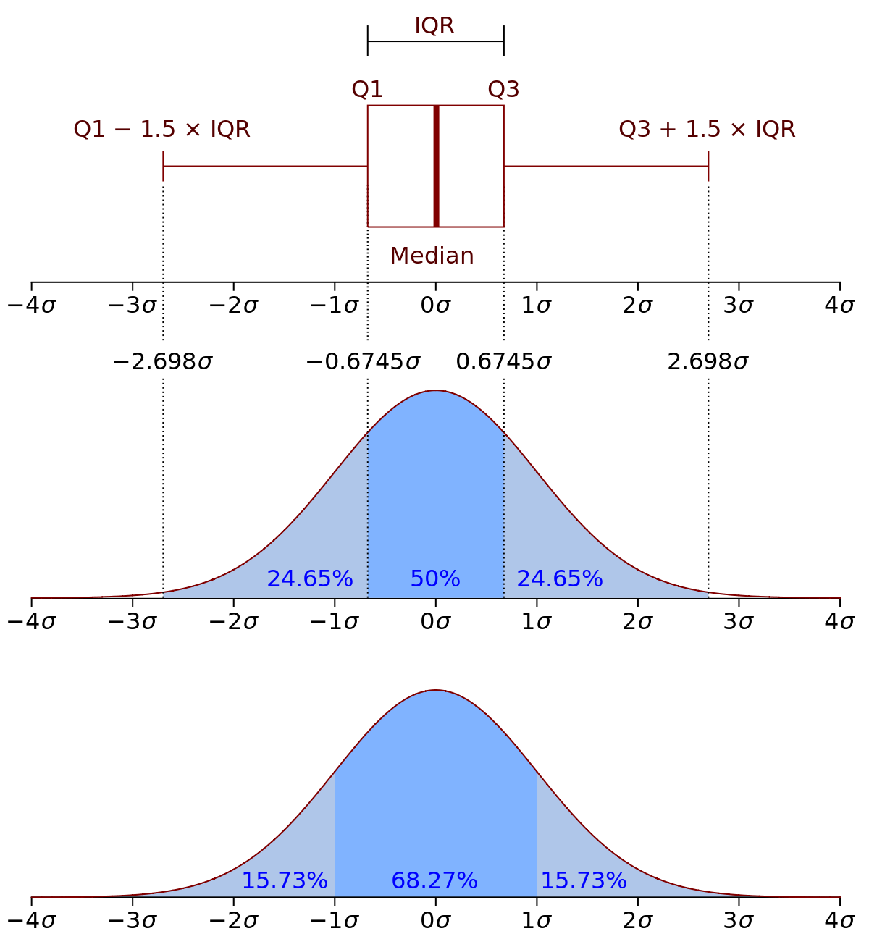
IQR Score
Wikipedia: interquartile range (IQR), also called midspread or middle 50%, or technically H-spread, is a measure of statistical dispersion, being equal to difference between 75th and 25th percentiles, or between upper and lower quartiles,
IQR = Q3 − Q1.
Measure of dispersion similar to standard deviation or variance, but is much more robust against outliers.

Slide 65
Percentiles
assume a certain percent of value from top or the
bottom as an outlier.
A common mistake is using percentiles according to range
of data
e.g., if data ranges from 0 to 100; top 5% is not values between 96 and 100.
Top 5% means values that are out of 95th percentile of data.

Slide 66
Handling Outliers
An Outlier Dilemma: Drop or Cap
Correcting
Removing
Z-score
IQR Score

Slide 67
Binning
Binning – can be applied on both categorical and numerical data
Example

Slide 68
Binning
Motivation: make model more robust and prevent overfitting
Has a cost to performance.
Key point : Trade-off between performance and overfitting
Numerical binning: binning might be redundant due to its effect on model
performance.
• Categorical binning: labels with low frequencies may affect robustness negatively.
Assigning a general category to these less frequent values helps to keep robustness of model.

Slide 69
Log Transformation
Helps handle skewed data and after transformation, distribution becomes more approximate to normal
.
Usually, magnitude order of data changes within range of data.
Also decreases effect of outliers, due to normalization of magnitude differences and model become more robust.

Slide 70
Log Transformation
Helps handle skewed data and after transformation, distribution becomes more approximate to normal
.
Usually, magnitude order of data changes within range of data.
Also decreases effect of outliers, due to normalization of magnitude differences and model become more robust.

Slide 71
Log Transformation
Pre-req to apply log transformation - Data should be only positive, lest error
You can add 1 to make data positive across the feature

Slide 72
Grouping
Tidy data: dataset where each row is an instance, each column is a feature
Datasets that are not tidy can use groupings. Like transactions
Key Point: Decide aggregation function

Slide 73
Grouping
Aggregating categorical columns:
Highest frequency: the max operation for categorical columns
Make a Pivot table: This would be a good option if you aim to go beyond binary flag columns and merge multiple features into aggregated features, which are more informative.
Apply one-hot encoding

Slide 74
Grouping
Numerical columns are mostly grouped using:
• Sum
• Mean

Slide 75
Splitting
Usually, dataset violates tidy data principles
Split function is a good option,
however, there is no one way of splitting features

Slide 76
Scaling
In most cases, the numerical features of the dataset do not have a
certain range and they differ from each other.
age and income columns cannot have same range
from ML pov, how to compare the 2 columns?
It is important for algorithms that work based on distance: such as k-NN or k-Means
there are two common ways of scaling: Normalization, and Standardization

Slide 77
Normalization
Or min-max normalization, scale all values in a fixed range between 0 and 1.
Transformation does not change distribution of features
NOTE: Due to decreased standard deviations, effects of outliers increases. So before normalization, it is recommended to handle outliers.

Slide 78
Normalization
Example:

Slide 79
Standardization
Standardization (or z-score normalization) scales the values while taking
into account standard deviation.
mean is shown as μ and standard deviation is shown as σ.
If standard deviation of features is different, range would also differ from each other.
Reduces effect of outliers in features

Slide 80
Standardization
Example:

Slide 81
Attributions
Some material is from “Feature Engineering for Machine Learning by Alice Zheng and Amanda Casari (O’Reilly). Copyright 2018 Alice Zheng and Amanda Casari, 978-1-491-95324-2.”
Some of these slides are based on material on from a DS class taught in MILA, Montreal which was adapted from towardsdatascience.

